Slide 1
OPERATING SYSTEMS ,
LINUX & BASH SCRIPTING

Slide 2
OPERATING SYSTEMS
An operating system or an OS is software that works as an interface between hardware components and you the user.
It enables other programs to run. Each computer system, whether it is desktop, laptop, tablet, or smartphone, all must have an OS to provide basic functionalities for the device.
Some widely used operating systems are Windows, MacOS, Android, iOS, etc.
The most important functions of operating systems include:
  Processor management
  Memory management
  Device management
  File management
  Security
  Job scheduling

Slide 3
Now to perform the functions mentioned above, the operating system has two major components:
  Shell
  Kernel
Shell handles user interactions. It is the outermost layer of the OS and manages the interaction between user and operating system by Prompting the user to give input , Interpreting the input for the operating system ,Handling the output from the operating system.
This interaction of the user and the shell can be done through a shell script.
The kernel is the core component of an operating system for a computer (OS). All other components of the OS rely on the core to supply them with essential services.
The Kernel serves as the primary interface between the OS and the hardware.

Slide 4
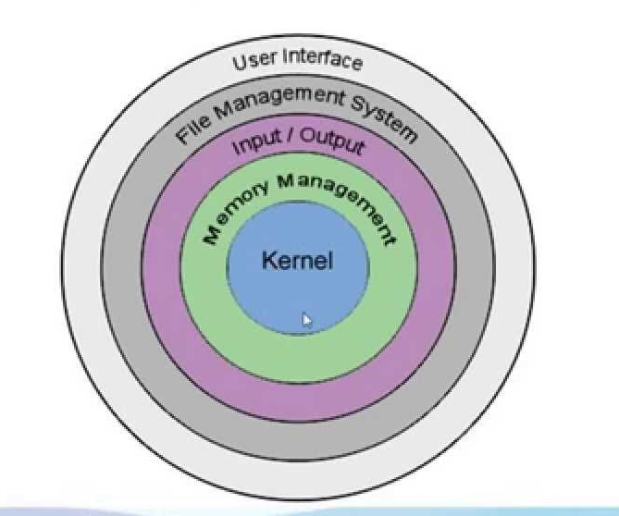

Slide 5
Fun Fact...
When people say “I use Linux,” what are they actually referring to?
Linux isn’t technically an operating system itself, but a kernel that serves as the foundation for a fully packaged operating system.

Slide 6
LINUX
Linux is a family of free and open-source software operating systems built around the Linux kernel.
Linux has a number of different versions to suit any type of user.
These versions are called distributions (or, in the short form, “distros”).
Popular Linux distributions include:
LINUX MINT , MANJARO ,DEBIAN ,UBUNTU, ANTERGOS, SOLUS ,FEDORA , ELEMENTARY OS , OPENSUSE

Slide 7
So with this understanding,the shell is the interface between the kernel and us the user.
For us to communicate with the Kernel we need a shell .
For the Linux Kernel several types of shells were made they include :
  The Bourne Shell – Denoted as sh
  The GNU Bourne-Again Shell – Denoted as bash
  The C shell – Denoted as csh
  The Korn Shell - Denoted as Ksh
For Ubuntu based Linux distributions Bash(Bourne Again Shell) is the default shell that is used to interact with the Linux Kernel.
Mac's default shell is either zsh (Z shell) or bash (Bourne-again Shell).This default shell is determined by the version of macOS you're running.

Slide 8
For us to interact with the shell in our case the bourne again shell (bash) we use a tool known as a command line interface (CLI) and this command line interface is accessed though our Terminal.
The terminal is where we will type in our “linux commands” which the shell(bash) will interpret and in turn communicate to the Linux Kernel to execute these commands.
The Bash (Bourne Again Shell) has its own programming language which enables us to issue a series of commands and instructions.
This series of commands and instructions are known as scripts.

Slide 9
Bash Scripting
Bash scripting refers to the process of creating and running scripts using the Bash (Bourne Again Shell) programming language.
Bash scripts are plain text files that contain a series of commands and instructions, similar to the commands you would type in a terminal.
Scripts are executed by the Bash interpreter.
Bash scripting is mostly used for automating repetitive tasks, performing system administration tasks, and creating complex workflows.
Bash scripting allows you to combine command-line utilities, control flow structures (such as loops and conditionals), variables, functions, and other programming constructs to create powerful and efficient scripts.

Slide 10
Bash Scripting is a powerful part of system administration and development used at an extreme level.
It is used by the System Administrators, Network Engineers, Developers, Scientists, and everyone who use Linux/Unix operating system.
They use Bash for system administration, data crunching, web application deployment, automated backups, creating custom scripts for various pages, etc.
Effectively, a Bash script is a computer program written in the Bash programming language.

Slide 11
What is a Shebang?
A Shebang directive, which always begins with the sequence #! can be found on the first line of a Bash or Python script.
In a Linux environment, the Shebang functions as an interpreter directive.
The Shebang #! symbol indicates the interpreter, or which version of an interpreter, to use when executing a script
When a Linux system executes a text file(script), it treats the Shebang as an interpreter directive by locating the correct interpreter and runs it, passing the name of the file to the interpreter as input.
There are two ways to use the Shebang directive and set the interpreter.
  Using the absolute path to the bash binary: #!/bin/bash
  Using the env utility: #!/usr/bin/env bash

Slide 12
One potential drawback can occur if the location of the interpreter changes, thus the Shebang directive must be updated at the same time. Otherwise, the script will stop working.
To avoid this we use the env utility which will always help us to find the path to the interpreter. So your script will always work even if the path to the interpreter changes
env uses the $PATH variable to search for the interpreter. It always returns the first match it finds.
Instead of #!/bin/bash its better to use #!/usr/bin/env bash
It makes your bash script portable. The advantage of #!/usr/bin/env bash
is that it will use whatever bash executable appears first in the running user's $PATH variable.

Slide 13
shellcheck tool
Shell Check is a static analysis tool for shell scripts. One can use it to finds bugs in your shell scripts.
It is written in Haskell. You can find warnings and suggestions for bash/sh shell scripts with this tool
Syntax for using shell check:
  shellcheck your_scriptname

Slide 14
For loops in bash
The basic syntax for a for loop in bash is :
  for item in list
  do
  # Actions to be performed on each item
  done
for item in list: This sets up the loop and specifies the list of items you want to iterate over. The item variable will hold each item from the list one at a time.
do: This keyword indicates the beginning of the loop body, where you'll define the actions to be performed on each item.
# Actions to be performed on each item: This represents the code or commands you want to execute for each item in the list.
done: This keyword signifies the end of the loop.

Slide 15
While loops in bash
In Bash scripting, the while loop allows you to repeatedly execute a block of code as long as a certain condition is true.
the basic syntax :
    while condition
    do
    # Actions to be performed
    done
condition: This is the condition that is checked before each iteration of the loop. If the condition is true, the loop continues executing. If the condition is false, the loop exits, and the script continues with the next line of code after the done keyword.
do: This keyword indicates the beginning of the loop body, where you define the actions to be performed.
# Actions to be performed: This represents the code or commands you want to execute inside the loop.
done: This keyword signifies the end of the loop.

Slide 16
the until loop
In Bash scripting, the until loop is similar to the while loop but with the condition inverted. The until loop executes a block of code repeatedly until a certain condition becomes true.
The basic syntax:
    until condition
    do
    # Actions to be performed
    done
condition: This is the condition that is checked before each iteration of the loop. If the condition is false, the loop continues executing. If the condition becomes true, the loop exits, and the script continues with the next line of code after the done keyword.
do: This keyword indicates the beginning of the loop body, where you define the actions to be performed.
# Actions to be performed: This represents the code or commands you want to execute inside the loop.
done: This keyword signifies the end of the loop.

